Slide 1










Machine Learning
Prepared By: Muhammad Ali Azeem bin Abdul Rahim

Slide 2

Outline
01
World of Data!
04
ML type
How big data skills became a new superpower
Supervised and Unsupervised ML model differences
02
Data Science
ML algorithm
05
Practicality and key features that drive the modern world
Exposure on simple yet effective ML model
03
Introduction to ML
06
ML Evaluation
To grasp the concept of machine learning
How do we evaluate the effectiveness of the model

Slide 3
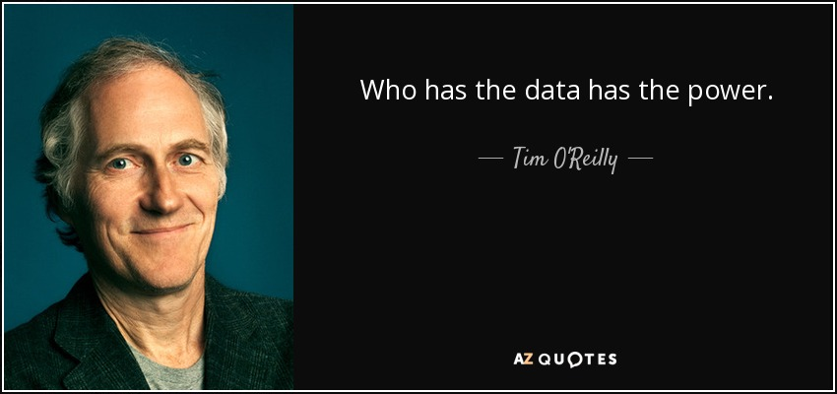
01

Slide 4
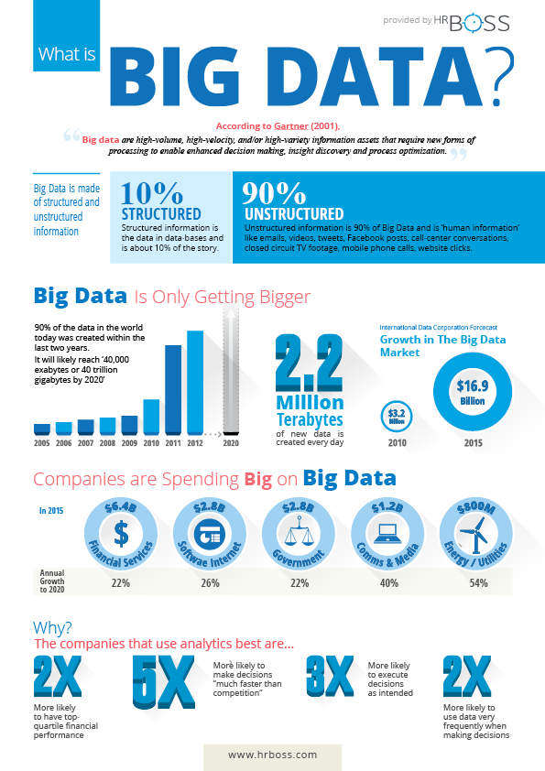
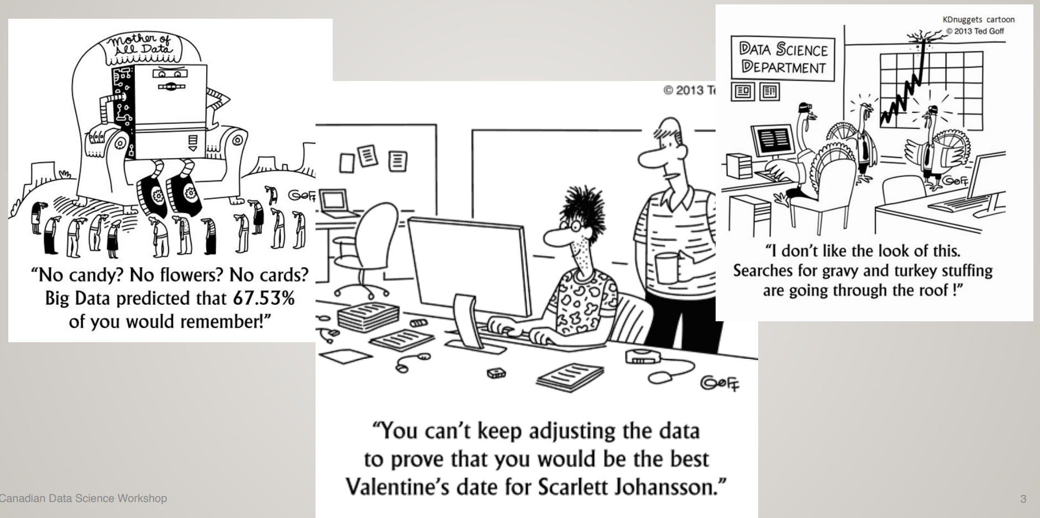
Data is inevitable

Slide 5


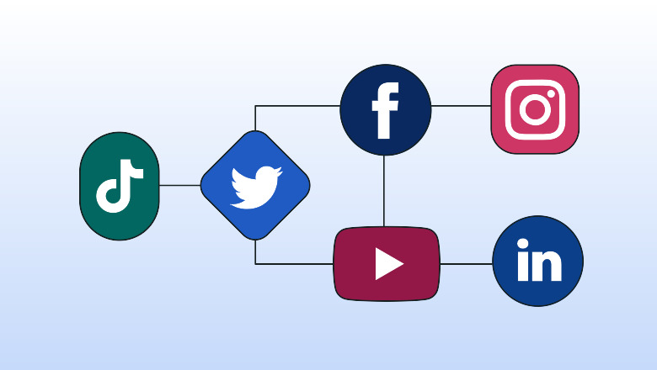
GIVE EXAMPLE OF DIGITAL DATA THAT YOU ENCOUNTER IN YOUR DAILY ROUTINE

Slide 6

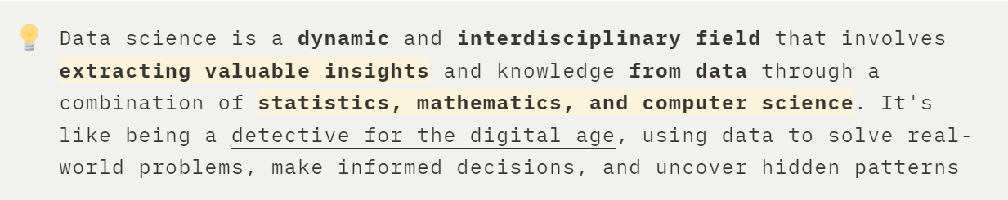
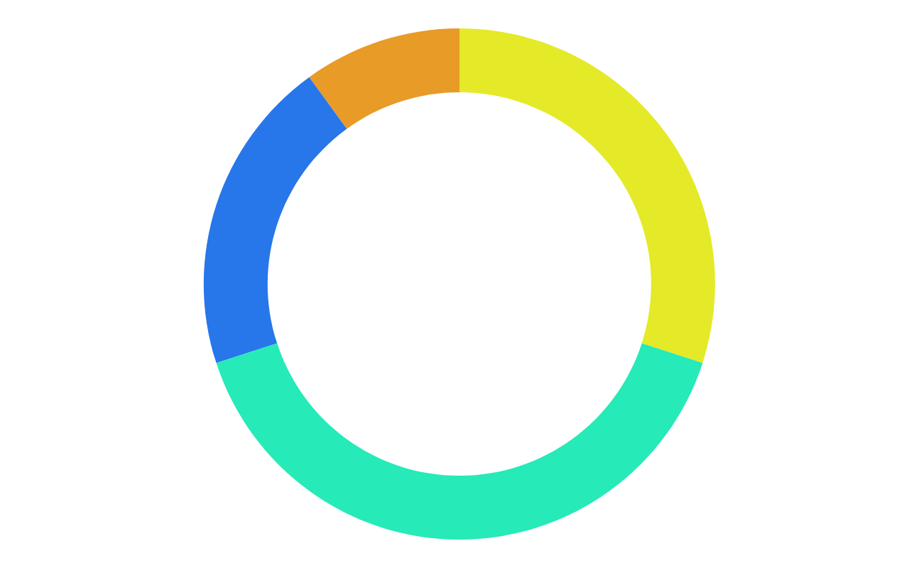
Data Science
02

Slide 7
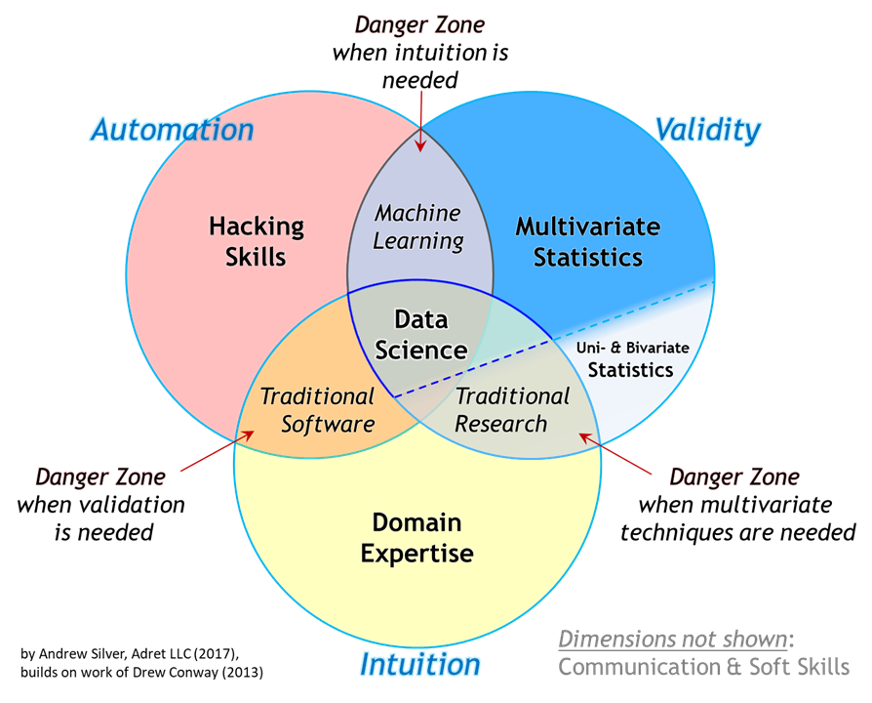

Slide 8
Why Data Science???
Unleash Creativity
It is not just about numbers
Using Data Science will
Solve Real-World Mysteries
Solve real-world puzzles and problem
Unleash Tech Superpower
Data science is where technology meets magic
Connect with Your Passion
it's a ticket to apply your interests in the real world

Slide 9
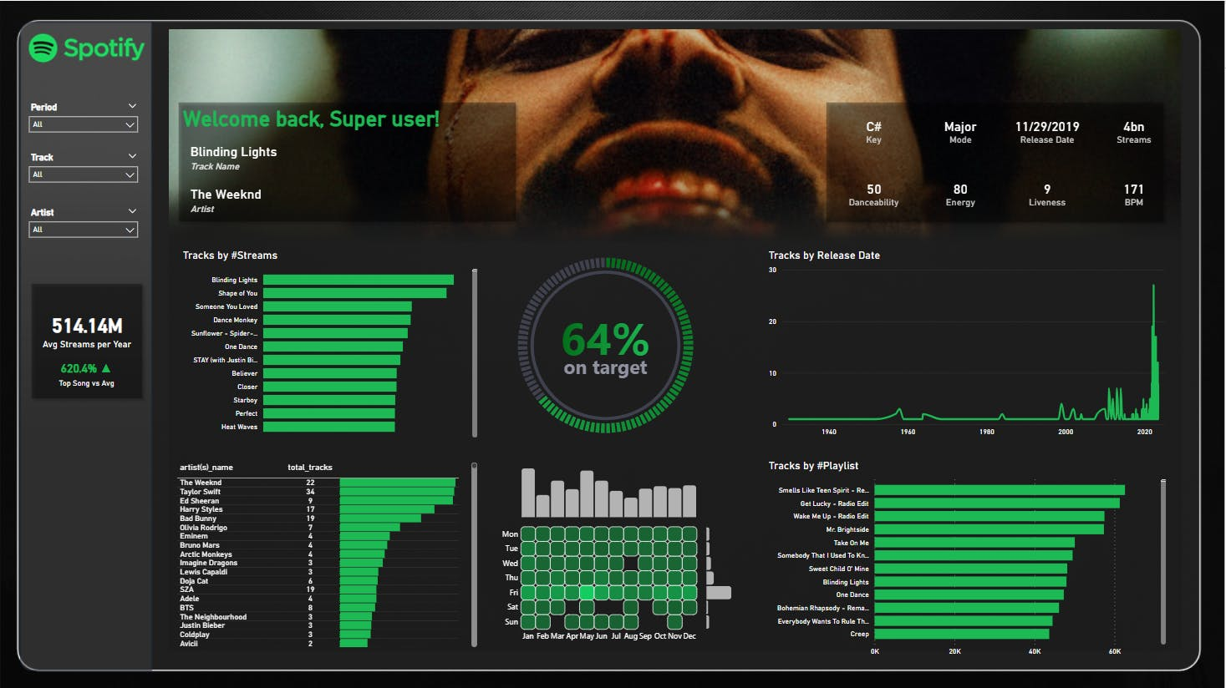
Unleash Creativity
Spotify Dashboard

Slide 10
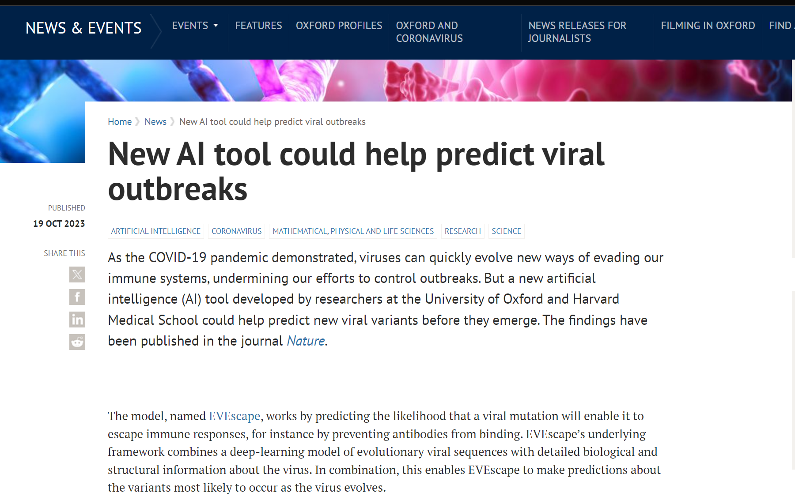
Solve Real-World Mysteries
Predict pandemic

Slide 11
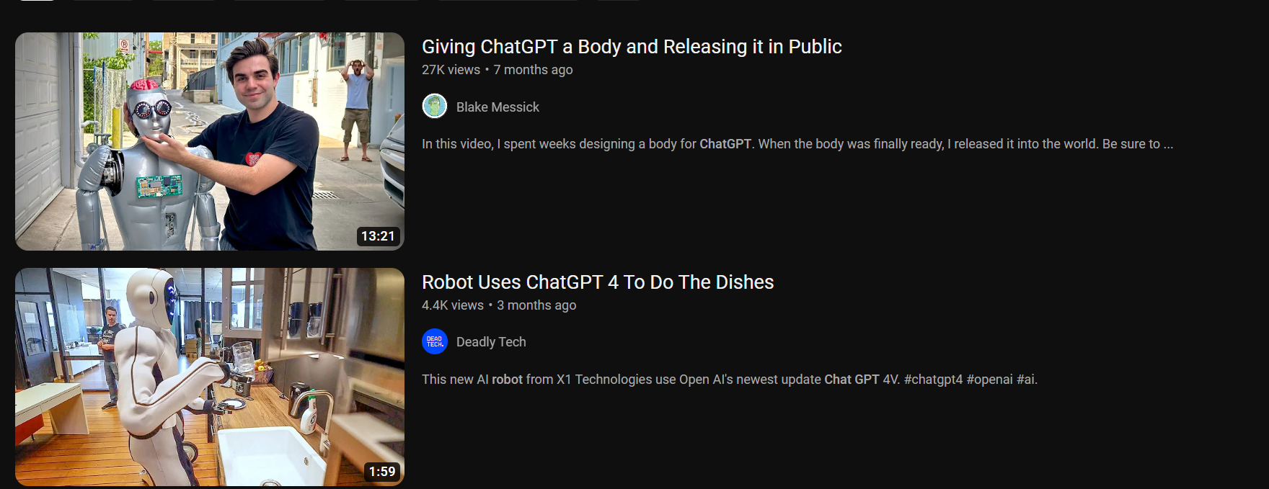
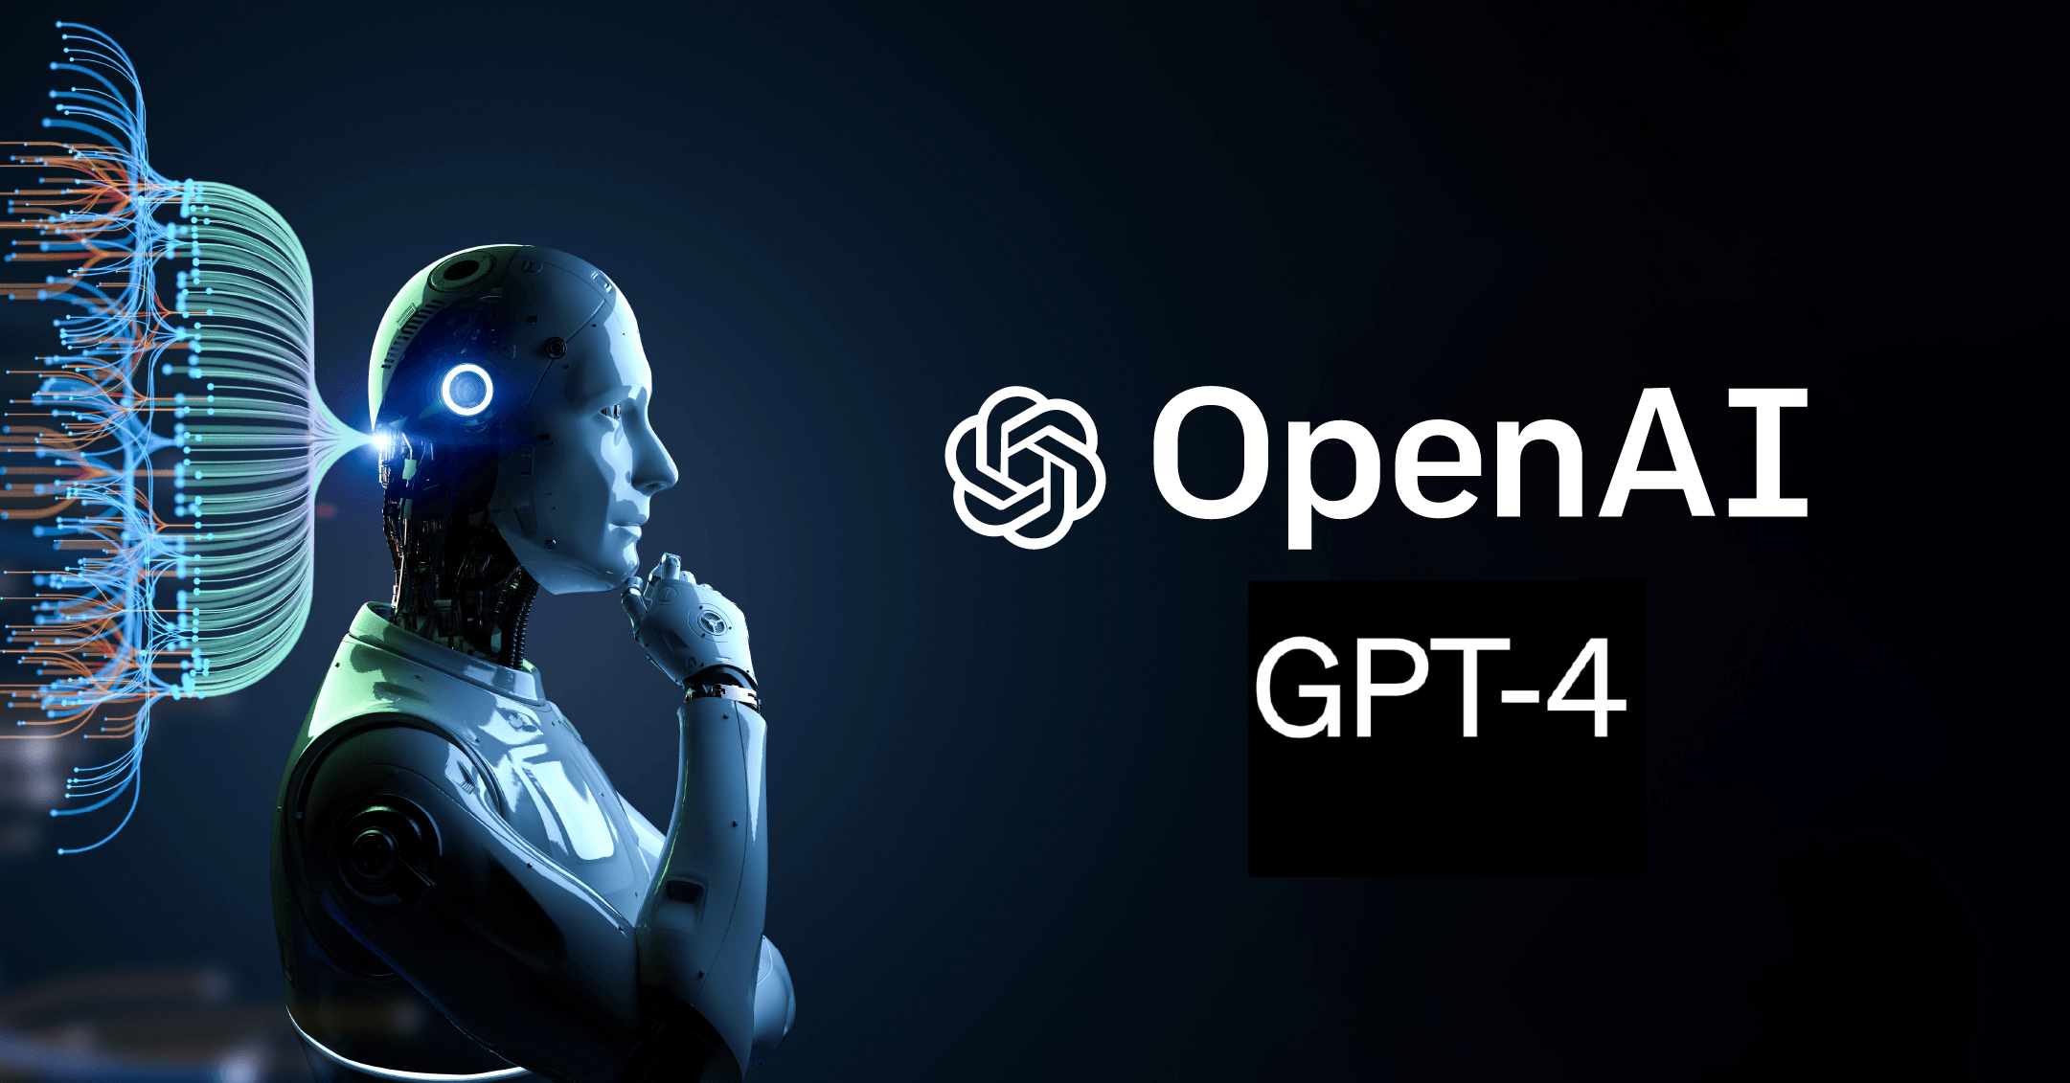
Unleash Tech Superpower
Create everything that you’ve ever dream of !

Slide 12
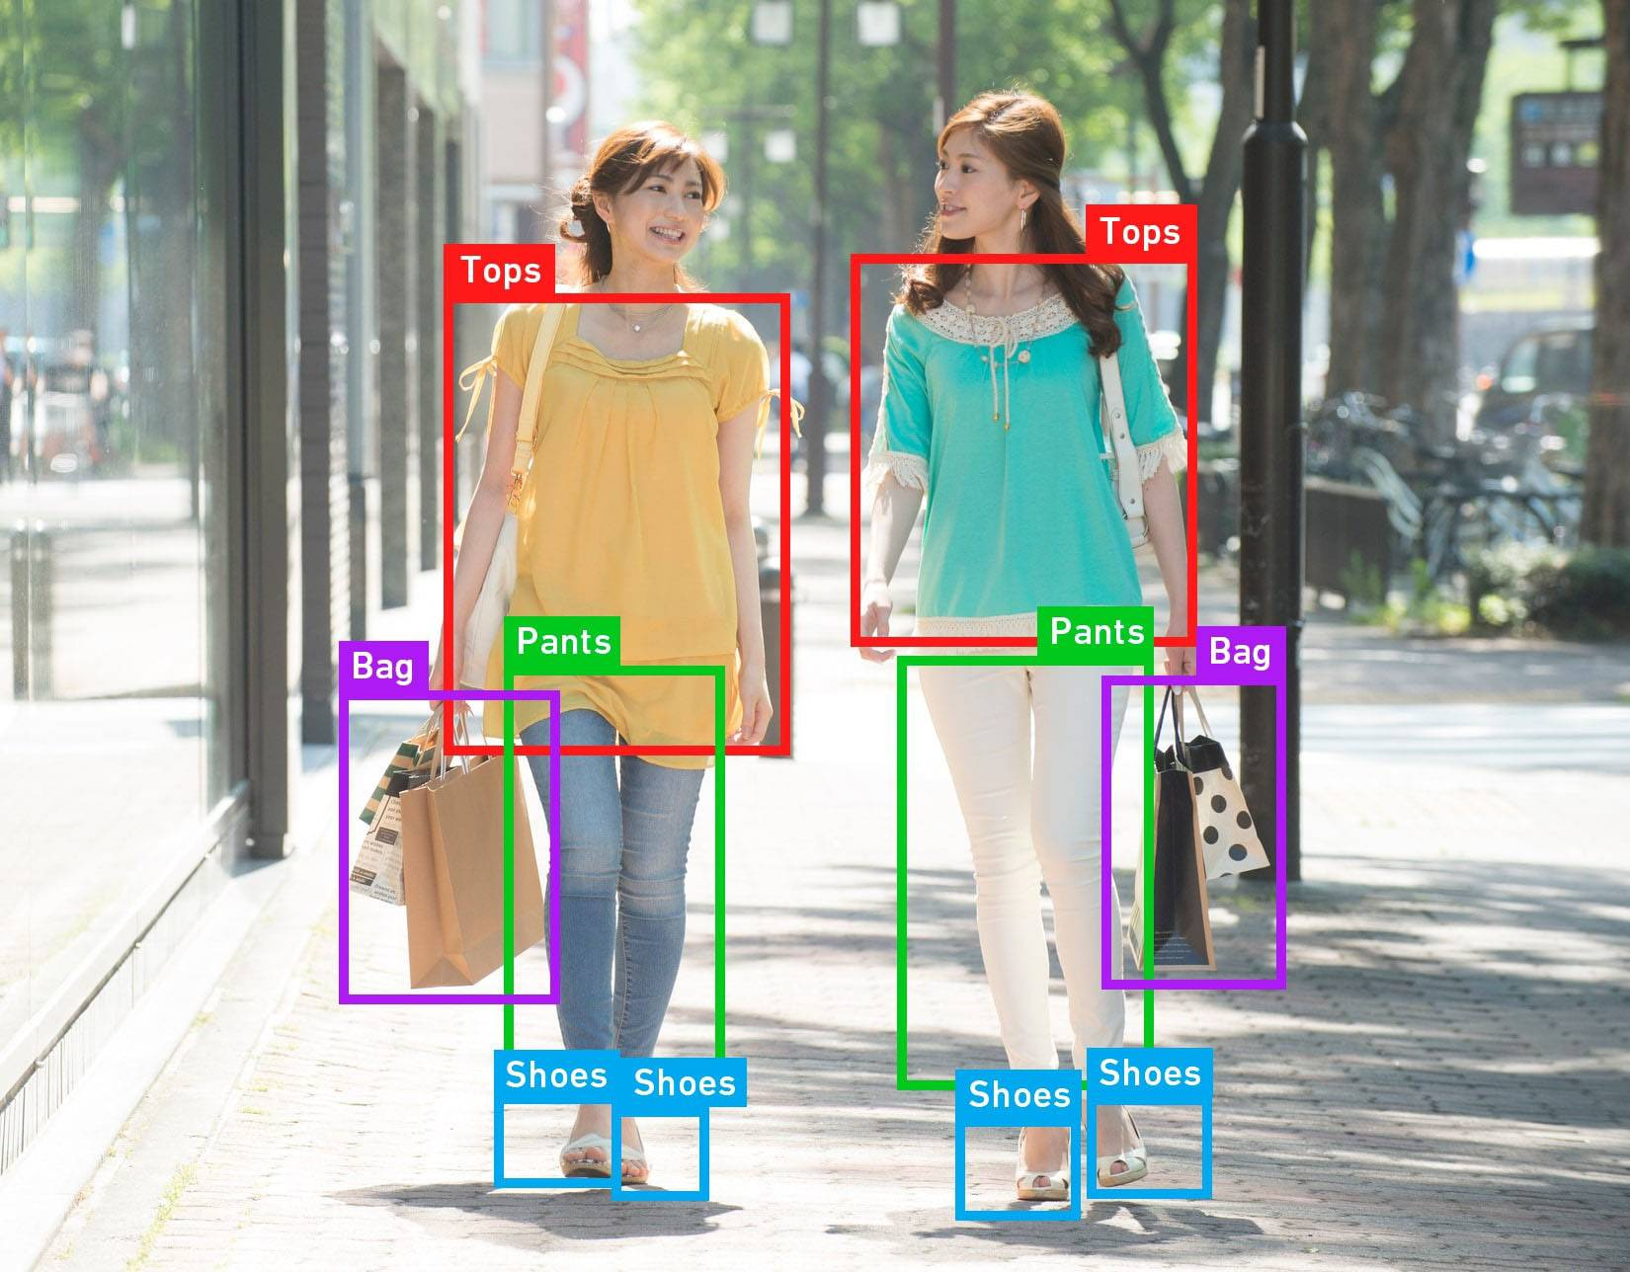
Connect with Your Passion
Predict the next big style

Slide 13
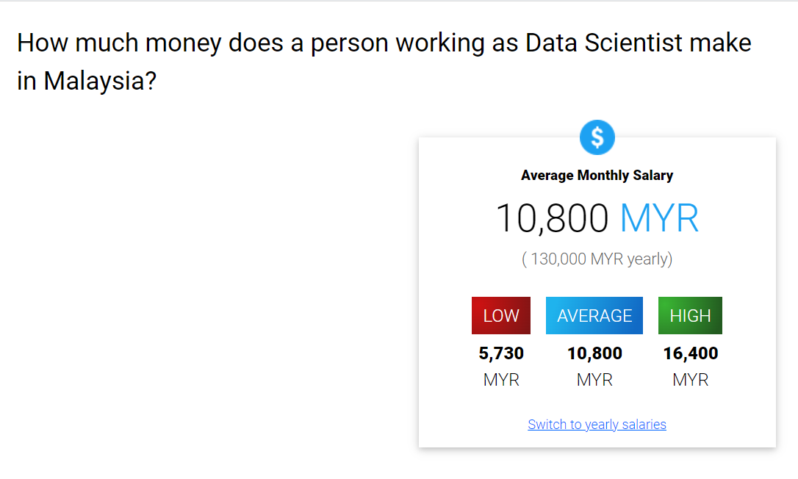
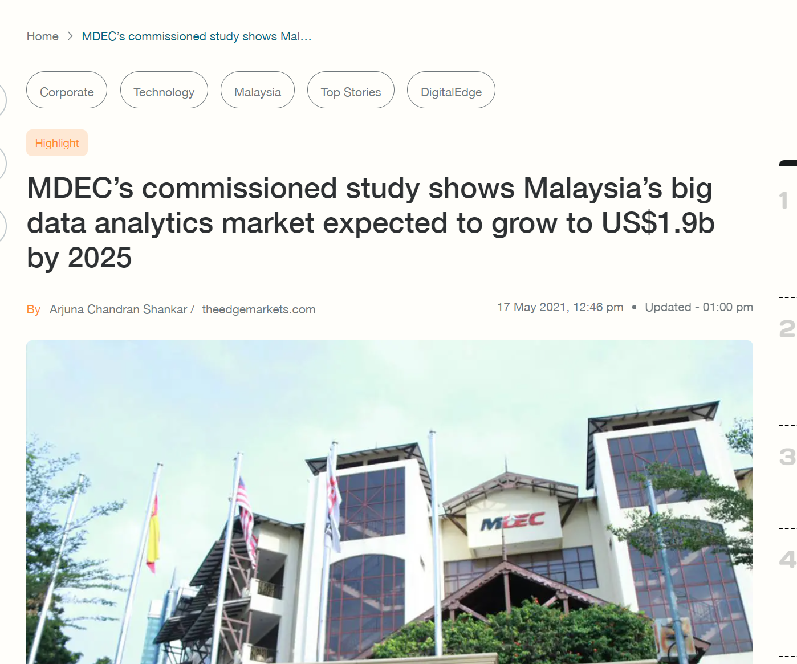
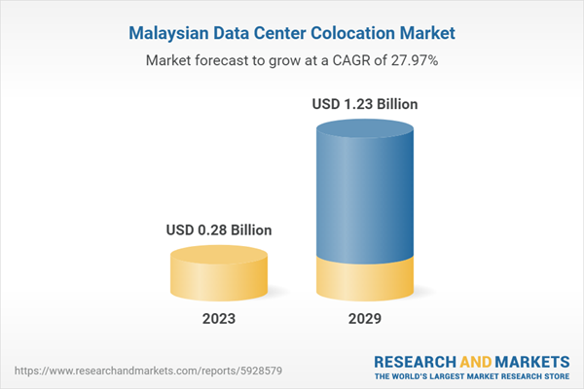
Reflect on the demand of Data Scientist
Source :SalaryExplorer

Slide 14
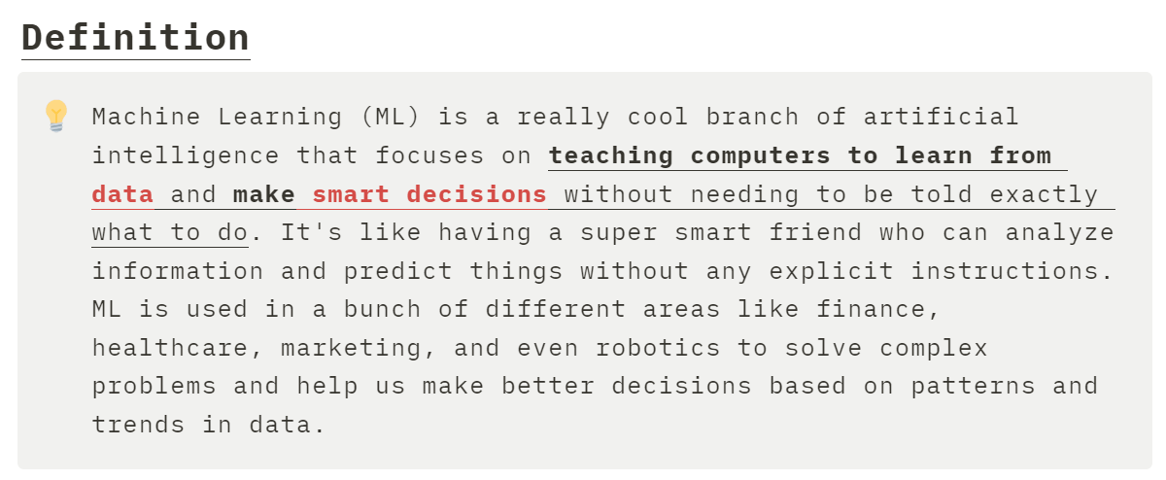
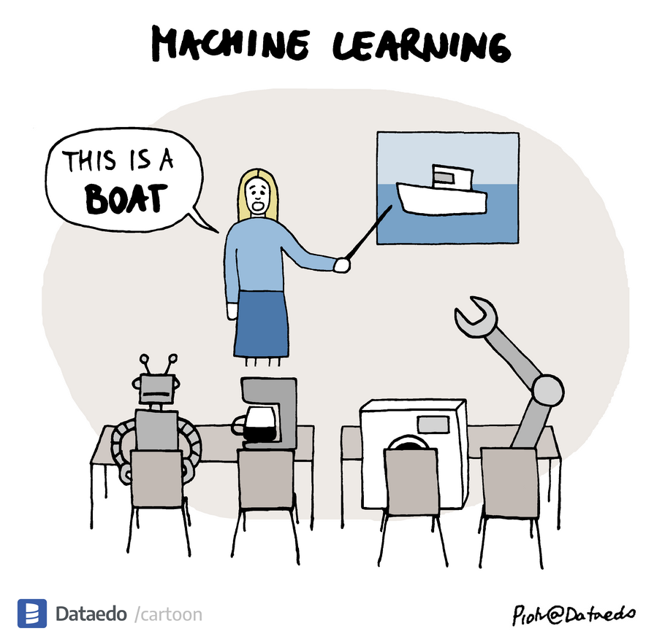
Introduction to Machine Learning
03

Slide 15
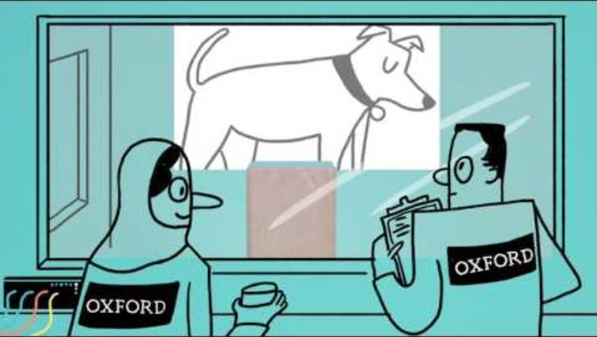
https://www.youtube.com/watch?v=f_uwKZIAeM0&ab_channel=OxfordSparks

Slide 16
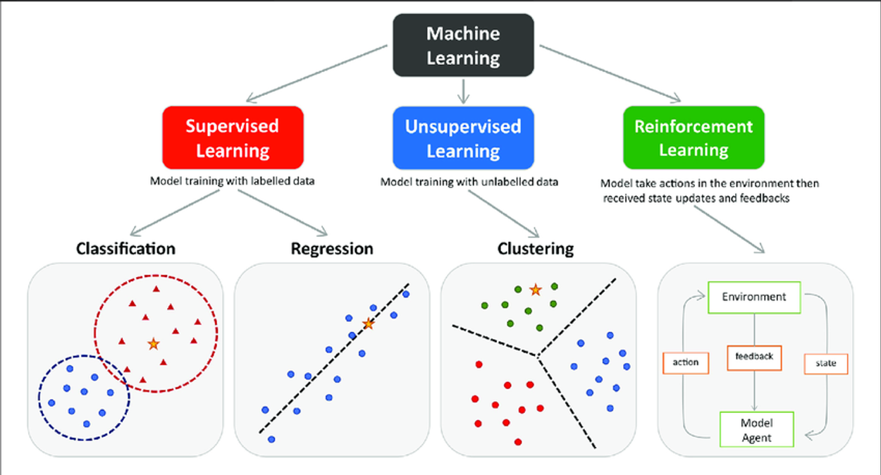

Slide 17
Type of Machine Learning
04
Supervised
Unsupervised
Definition: Supervised learning uses labeled data for training machine learning models.
Labeled Data: Input data comes with pre-assigned output labels.
Objective: The goal is to find a mapping function.
Definition: Unsupervised learning finds patterns in unlabeled data.
Objective: It seeks to discover the inherent structure and patterns.
Characteristics: No predefined output labels; the model discovers patterns on its own.
Vs

Slide 18
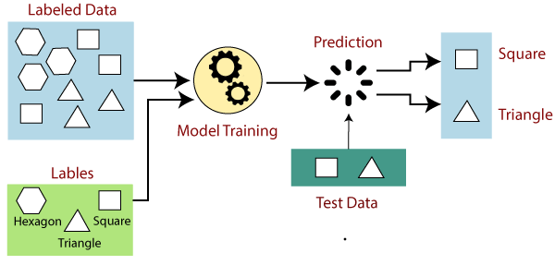

Slide 19
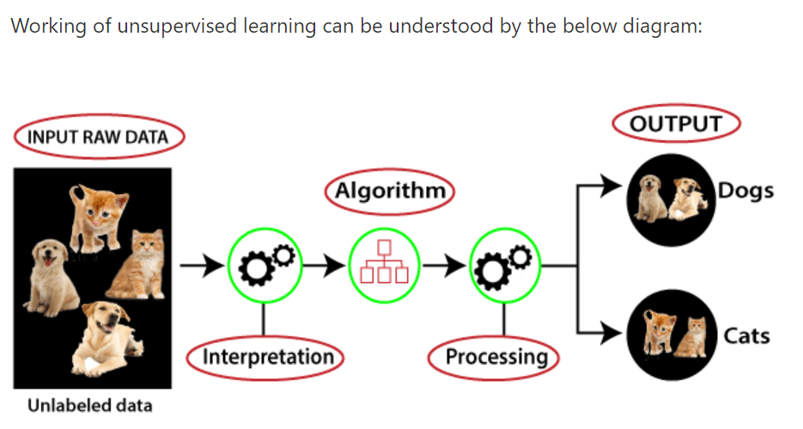

Slide 20


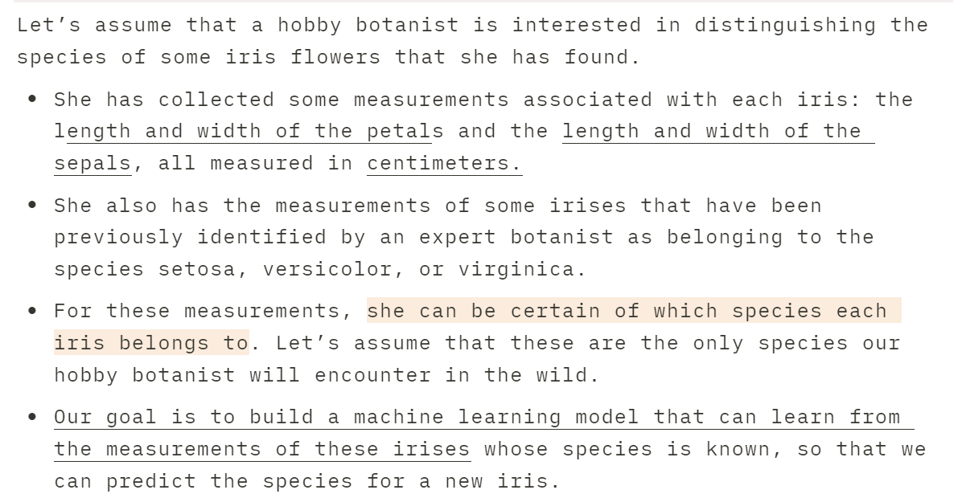

Slide 21
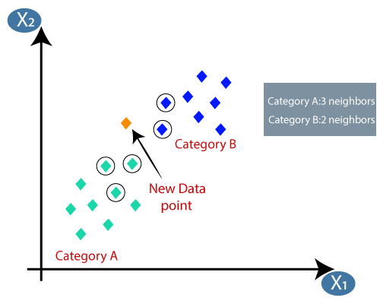
Example of ML Algorithm: K- nearest neighbour
05
Approach
It works based on the principle of proximity, where an instance is classified or predicted by the majority class or average of its k-nearest neighbors

Slide 22
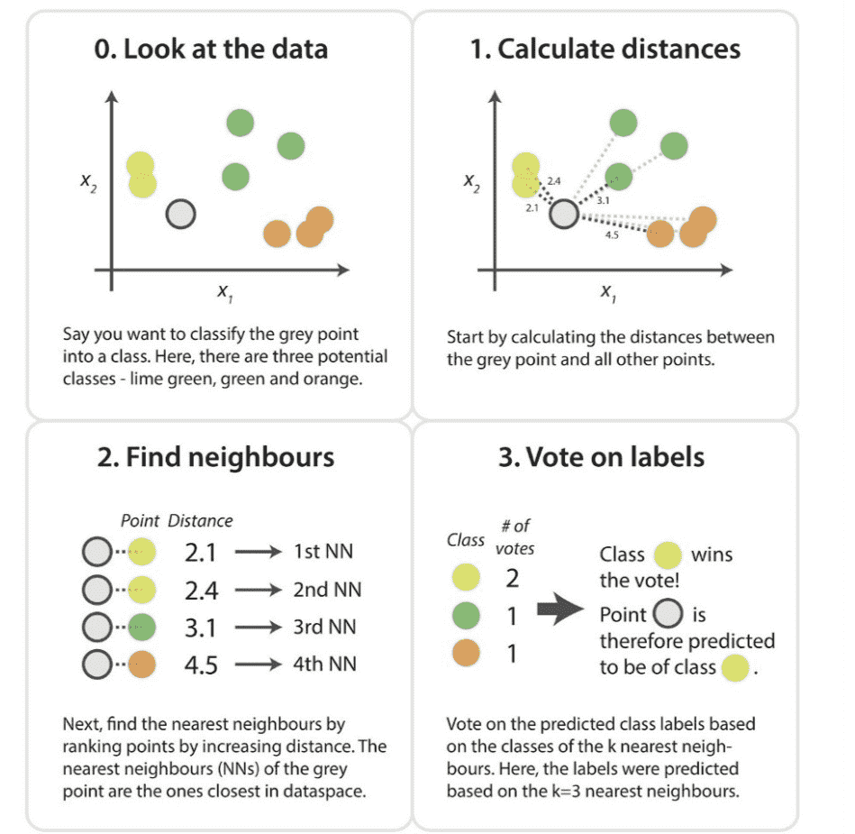

Slide 23
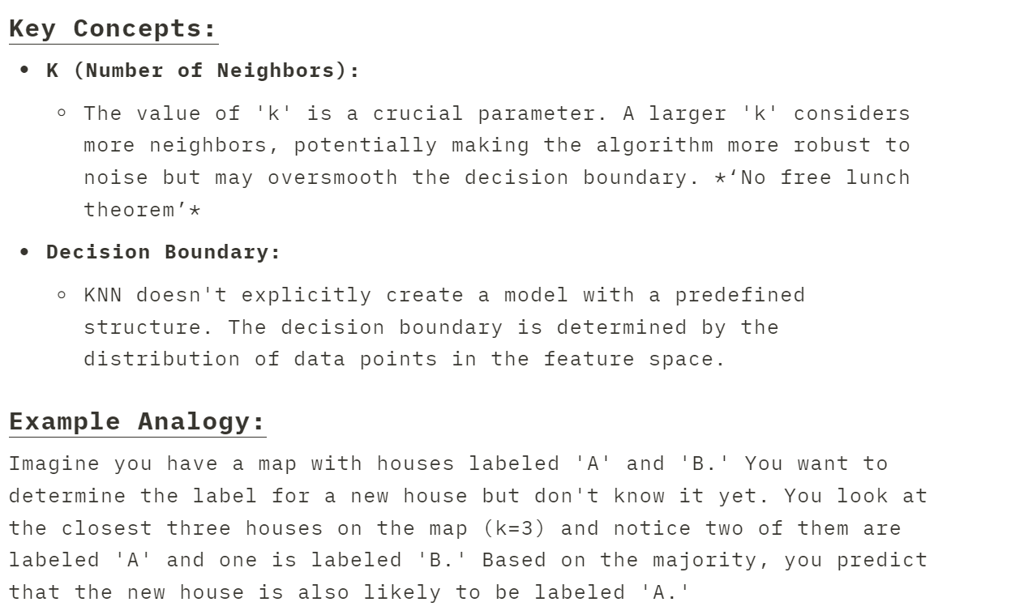
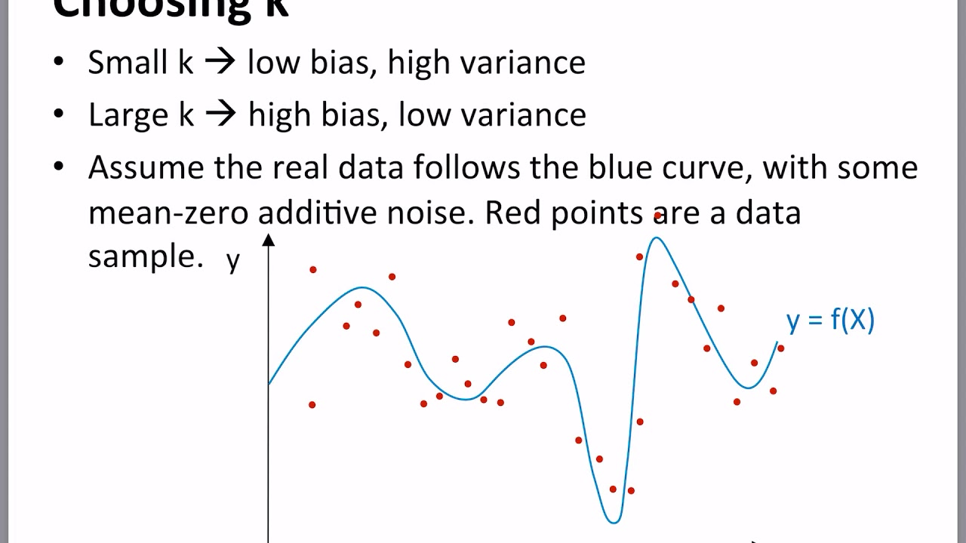

Slide 24


Slide 25
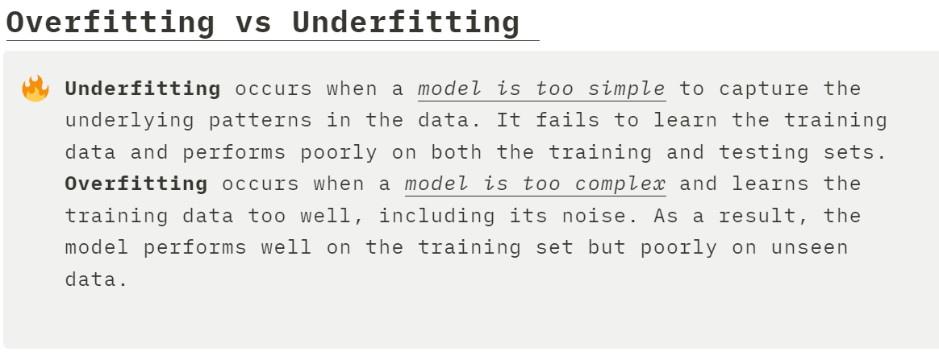
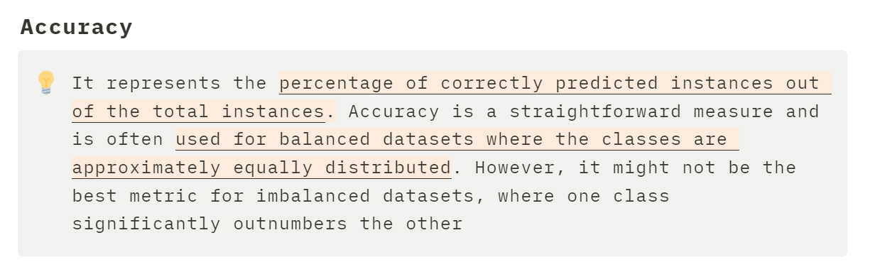
Evaluating the model

Slide 26
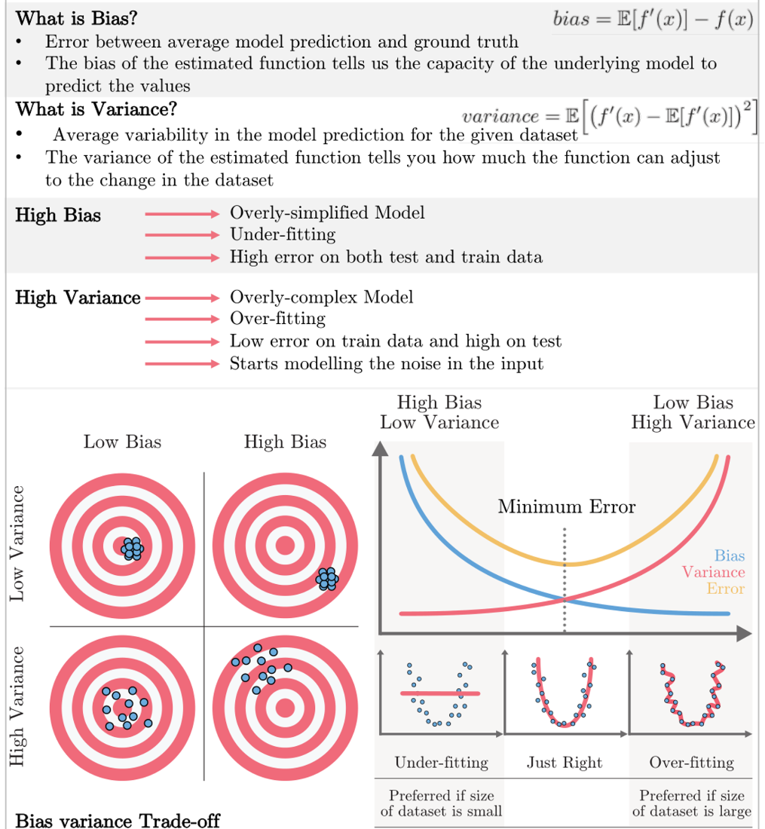
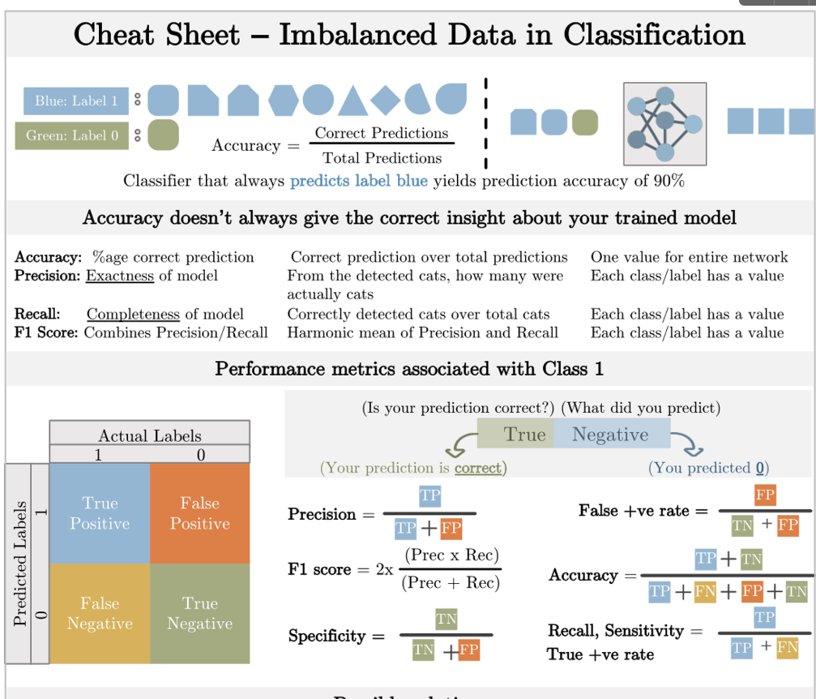

Slide 27
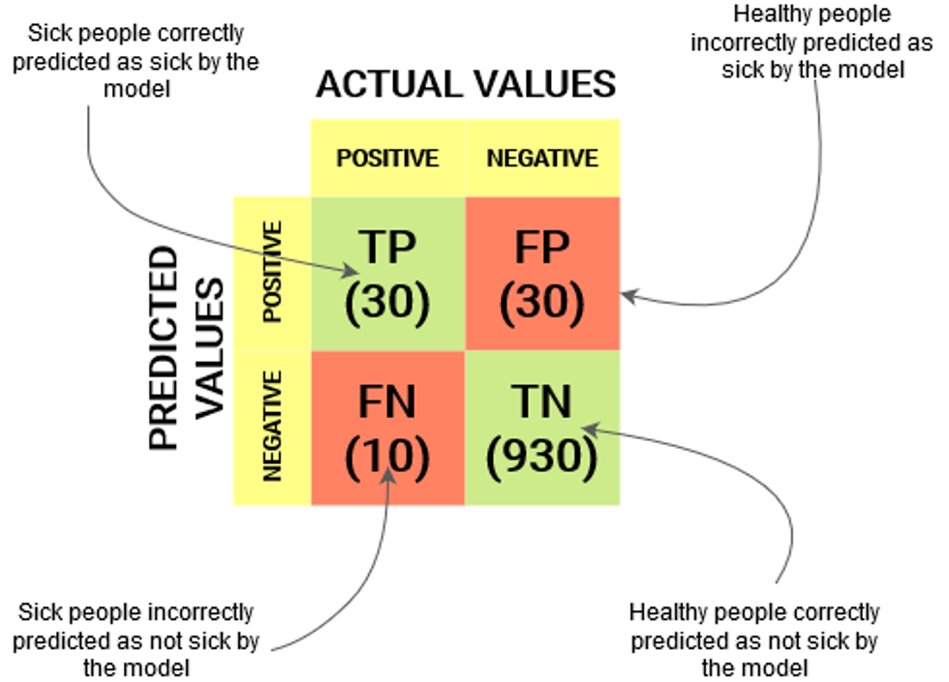
Confusion
Matrix

Slide 28
NO FREE LUNCH

Slide 29
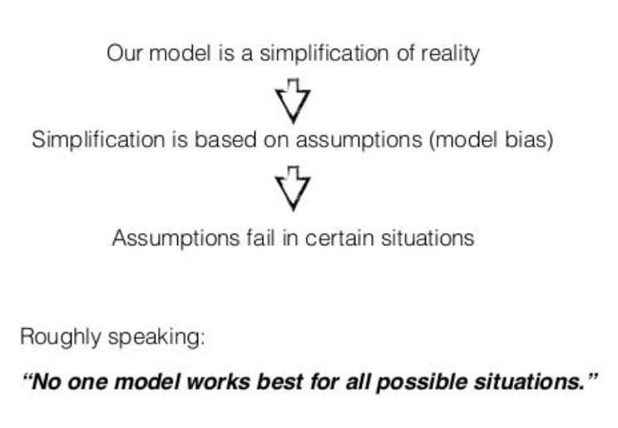
No free lunch theorem

Slide 30
Activity
#1 Teachable Machine :
Using the images provided, train your computer to recognize 4 type of animal( must be different)
#2 Rock Paper Scissor
# Quiz session

